Slide 1
Sprint 1
Shape Hero
Team Void Star

Slide 2
What has been done?
We have a functioning early iteration
We have Sound
We have a title screen, game screen, pause overlay, game over overlay, and options overlay
There is hit detection
There is score
There is a fail state
The game is endless

Slide 3
What has not been done?
We did not complete the leaderboard

Slide 4
What went well during the sprint
We all did our part
We used Git effectively
We all showed up to the meetings

Slide 5
What were some issues
Some tasks were a lot more difficult than others so we had to work together to complete them
Sometimes people were hard to get a hold of so we had to make sure we had a means of access

Slide 6
Revised product backlog for the next sprint
Our backlog of tasks seems to be on point for now
If anything we will need to think up stuff to add in order to keep busy
Changing rules
Difficulty Changes
The leaderboard
Polish for animations

Slide 7
Improvements that exist will be implemented
Shapes not spawning on eachother
Font not comic sans
Polish UI
Explosions/Animations

Slide 8
Projection of likely project completion dates
We are on pace and possibly early
We got all of the hard stuff out of the way

Slide 9
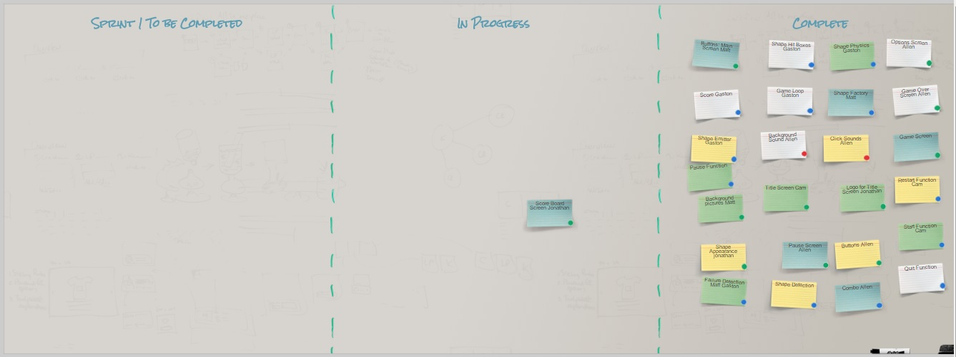
The Scrum Board

